Slide 1

Team Data Bytes - 12191

Slide 2
Sentence Transformers:
Sentence Transformers is a Python framework for state-of-the-art sentence, text, and image embeddings. Embeddings can be computed for 100+ languages and they can be easily used for common tasks like semantic search, and question answer retrieval.
The framework is based on PyTorch and Transformers and offers a large collection of pre-trained models tuned for various tasks. Further, it is easy to fine-tune your own models.

Slide 3
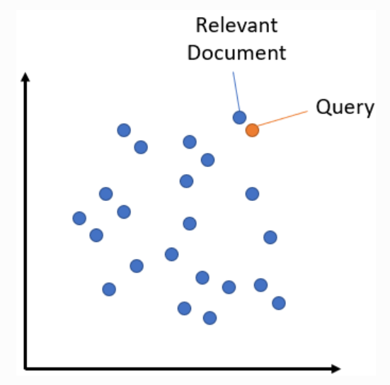
Semantic Search:
Semantic search seeks to improve search accuracy by understanding the content of the search query. In contrast to traditional search engines which only find documents based on lexical matches, semantic search can also find synonyms.

Slide 4
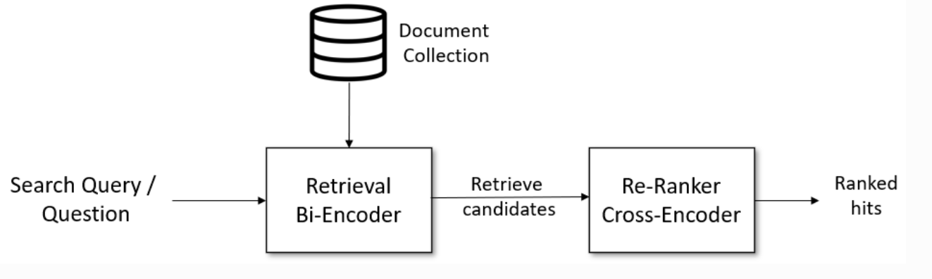
Question Answer Retrieval:
Given a search query, we first use a retrieval system that retrieves a large list of e.g. 100 possible hits which are potentially relevant for the query. For the retrieval, we can use either lexical search, e.g. with ElasticSearch.
In the second stage, we use a re-ranker based on a cross-encoder that scores the relevancy of all candidates for the given search query. The output will be a ranked list of hits we can present to the user.

Slide 5
AWS EC2:
Elastic Compute Cloud or EC2 is a virtual server that assists users to run numerous applications on the AWS cloud infrastructure. With AWS EC2, you get instances with different resource configurations of CPU, memory, storage, and networking.
Benefits of AWS EC2:
Scaling horizontally and vertically.
Excellent bandwidth which increases time efficiency.
Less worry about hardware failure.
Quicker and easier recovery.
Persistent Backup.

Slide 6
AWS RDS:
Amazon Relational Database Service (Amazon RDS) is a web service that makes it easier to set up, operate, and scale a relational database in the AWS Cloud. It provides cost-efficient, resizable capacity for an industry-standard relational database and manages common database administration tasks.
Benefits of Amazon RDS:
Easy to administer
Highly Scalable
Fast
Secure
Inexpensive

Slide 7
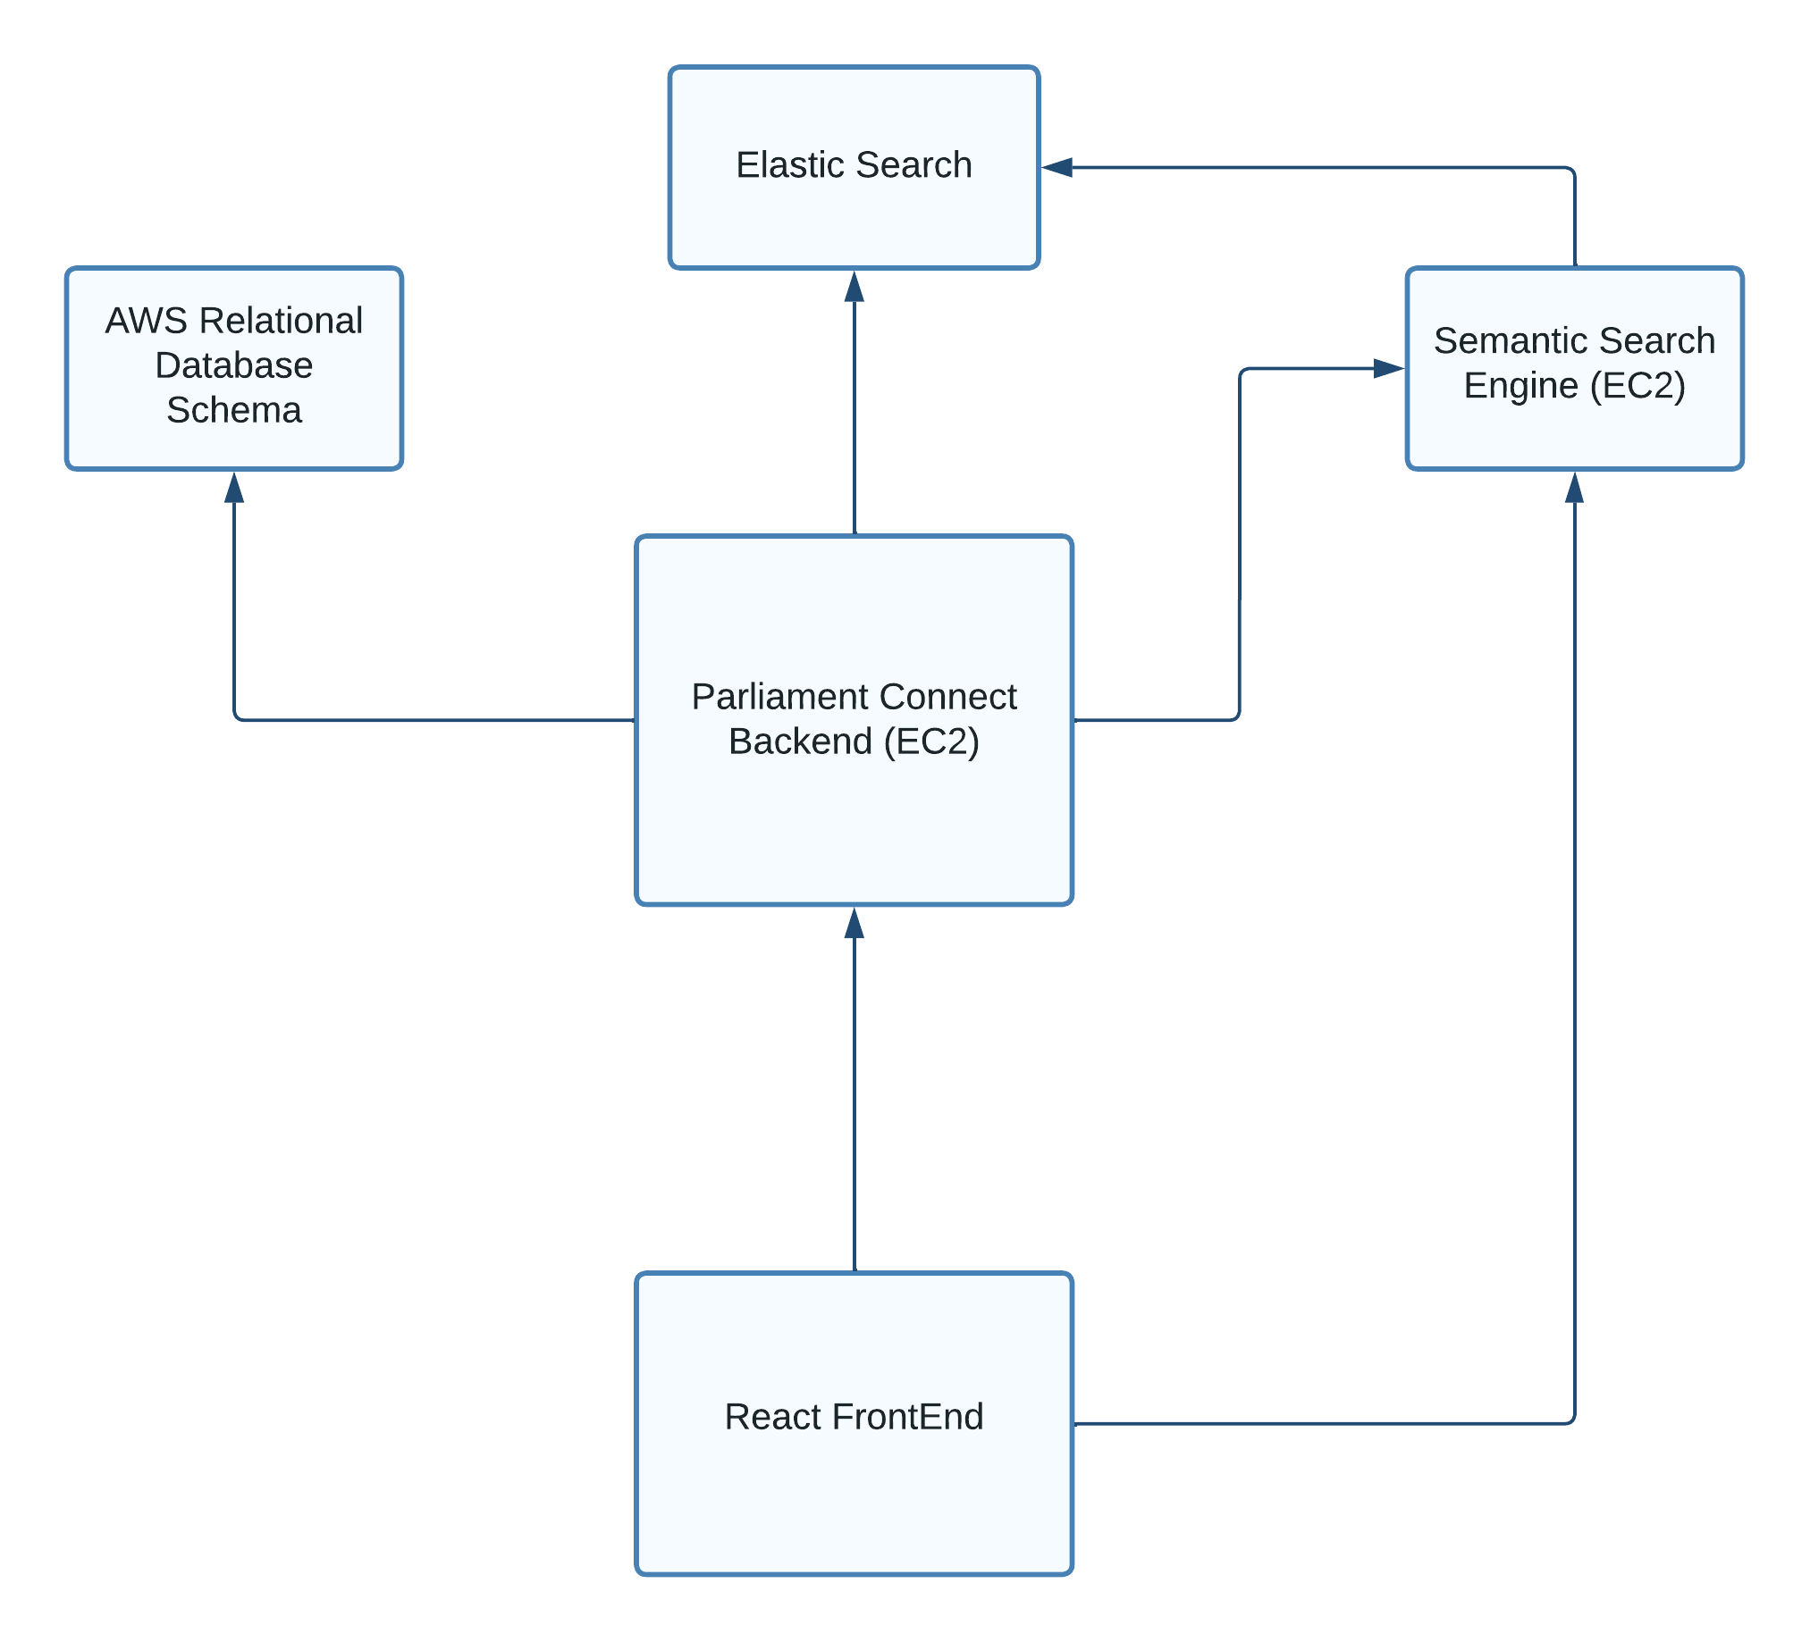
Process Flow:

Slide 8
Analytical Report

Slide 9
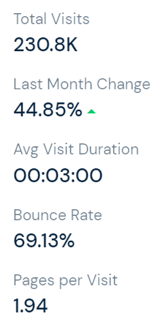
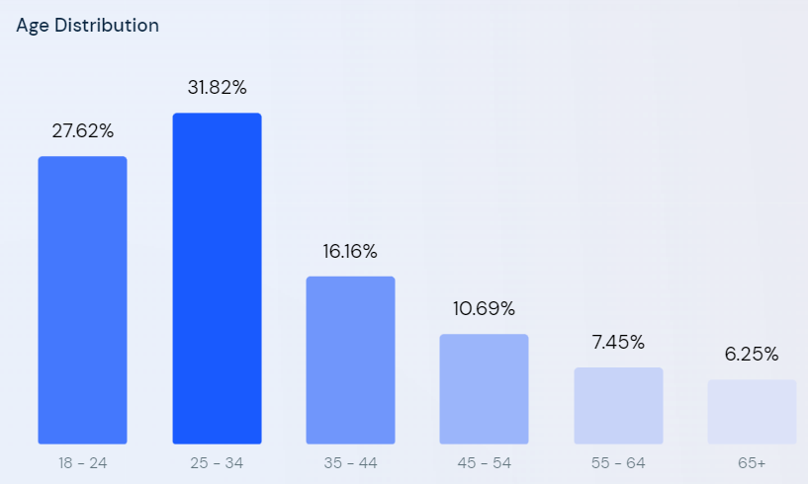
Traffic and Engagement - July(Lok Sabha):

Slide 10
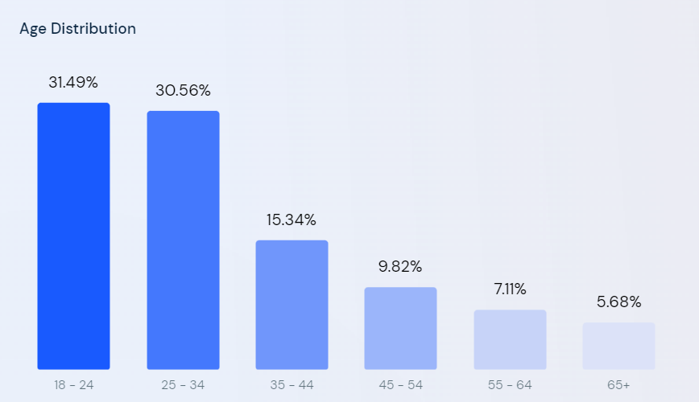
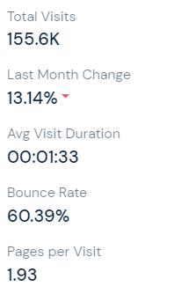
Traffic and Engagement - July(Rajya Sabha):

Slide 11
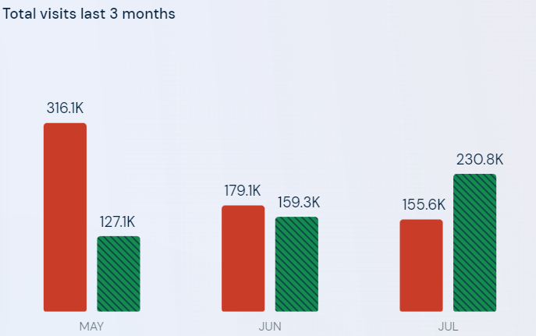

Total Visits Last 3 Months:

Slide 12
Checklist:
Mentoring Session 1:
Semantic Search Engine
Add a filter for Ministry in search.
Evaluation Session 1:
Semantic Search Engine with improvised query scores
Added accuracy score for the searched question
Admin Functionality( Upload Question, Parliament Auth, Unanswered Queries, Change Password, Index Management Console).

Slide 13
Agenda:
Adding a feature where ministers can answer the question raised to them and previously unanswered questions with a built in rich text editor.
Enhancing the search engine to such an extent where it is applicable for all regional languages.
Introducing Social Media Posts and awareness messages.
Integration of Polls by the Ministries to socialize the Parliamentary sessions and make the general public feel part of it to a certain extent.
Enhancing User-Interface and User-Experience.

